Slide 1
Group 2: Patient Survival Prediction
Adam Baer, Adam Crawford, Austin Funcheon, & Viraj Rane

Slide 2
Team Members
Adam Baer
Adam Crawford
Austin Funcheon
Viraj Rane
B

Slide 3
Background
Hospitals constantly looking to improve efficiency of operations while maximizing patient health
Statistics in health care useful in many areas
Allocation of resources and staff
Efficacy of new treatments
Needs assessment (what one community needs versus another)
Predicting patient outcome
Programming has become a fast and versatile tool in this industry
As we’ll see, a wide range of variables can be relevant to these problems
B

Slide 4
Purpose
To analyze the “Predicting Patient Deaths” dataset using multiple statistical methods in R
Research questions:
Can hospital deaths be predicted using the predictors in the data set?
Are certain admission criteria an indicator of a higher probability or risk of death?
By testing different methods, we can discuss the strengths and weaknesses of each and compare their overall performance
B

Slide 5
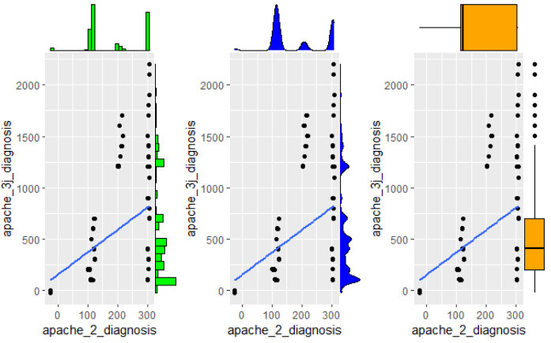
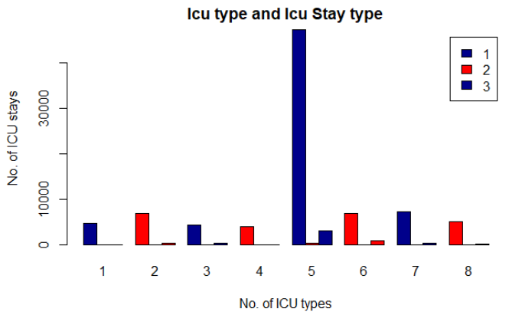
Data Visualization- Marginal plot and bar plot
The above marginal plot does not show a relationship between the values of apache 2 and apache 3j diagnosis.
In the first plot, the histograms are skewed to the left. We can see the outliers in the plot. The box plots are skewed to the left. The density plot is skewed to the right.
The result of bar plot shows that ICU type no. 5 i.e. "Neuro ICU" has the highest number of ICU stays.
B

Slide 6
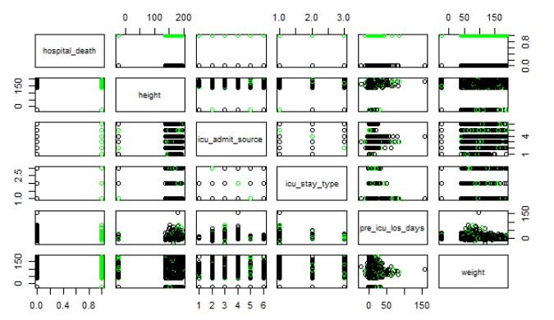
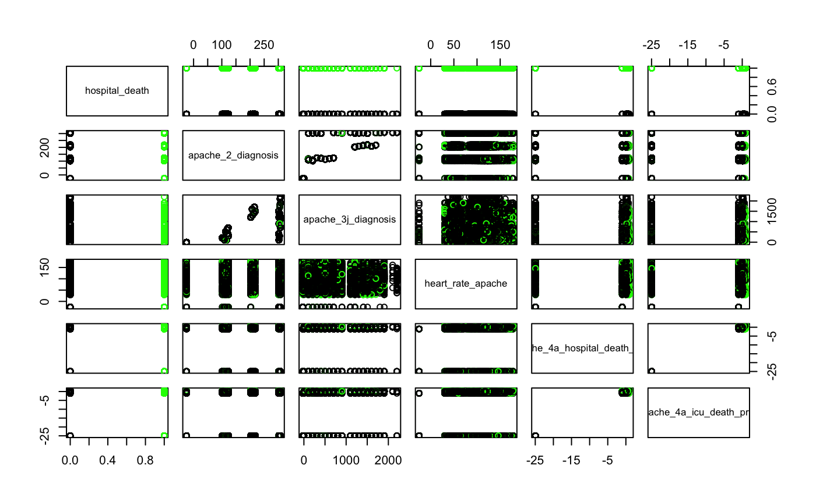
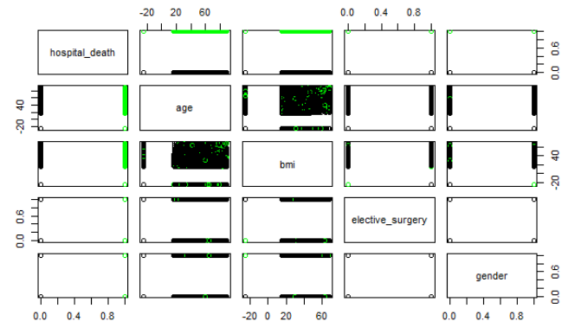
Data Visualization- pair plots of correlation
c

Slide 7
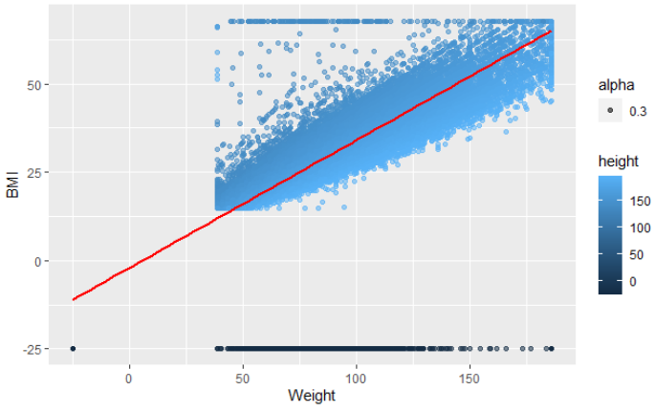
Data Visualization- scatter plot (method = lm)
There seems to exist a strong positive linear relationship between BMI and weight.
As weight increase the BMI also increases.
c

Slide 8
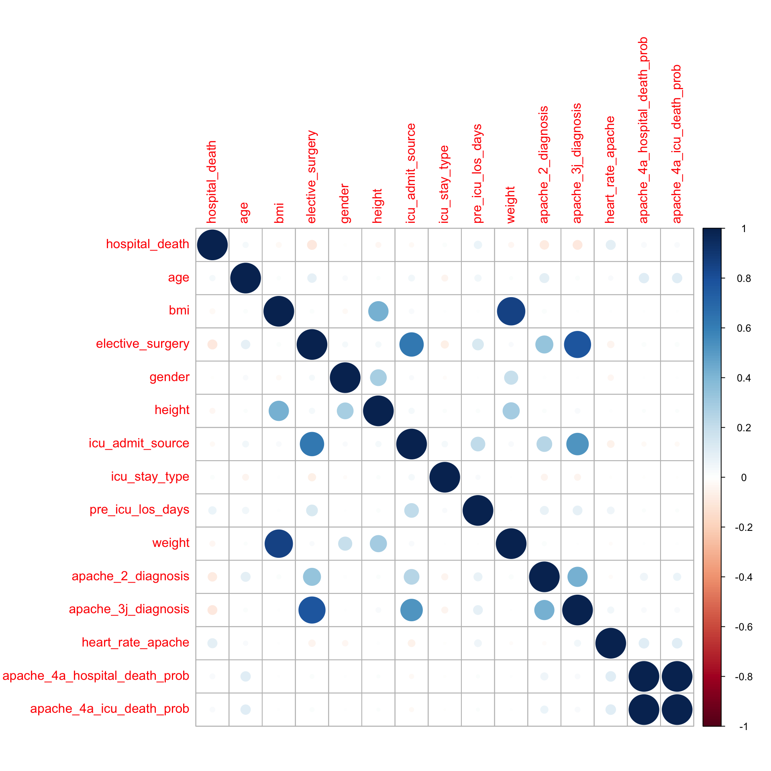
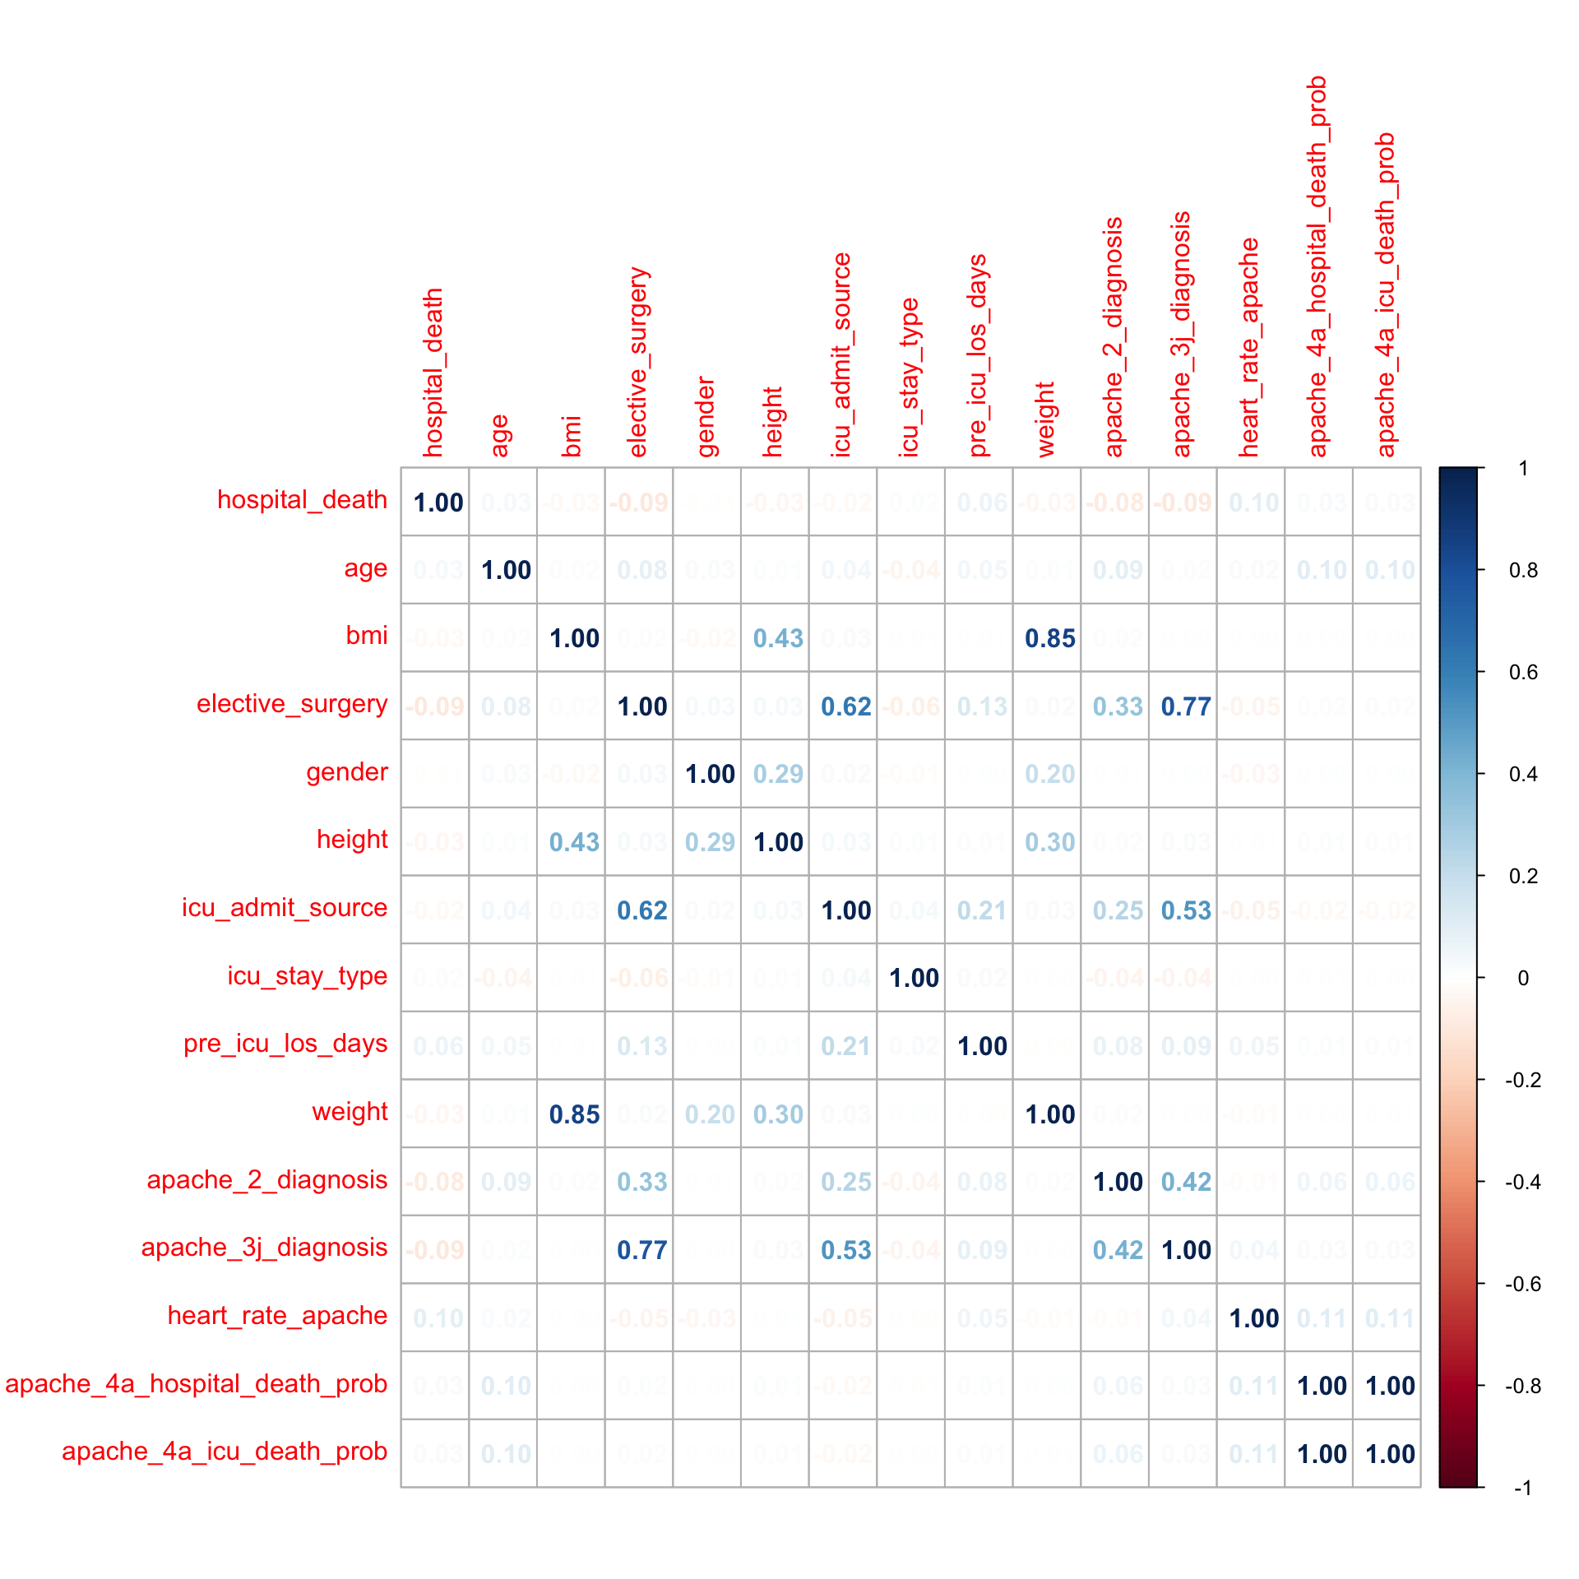
Data Visualization- Correlation plots
Circle correlation plot
Number correlation plot
The plot show correlations between variables bmi, weight, apache 3j diagnosis, elective surgery, icu admit source, and apache 2 diagnosis that are highly correlated to each other.
R

Slide 9
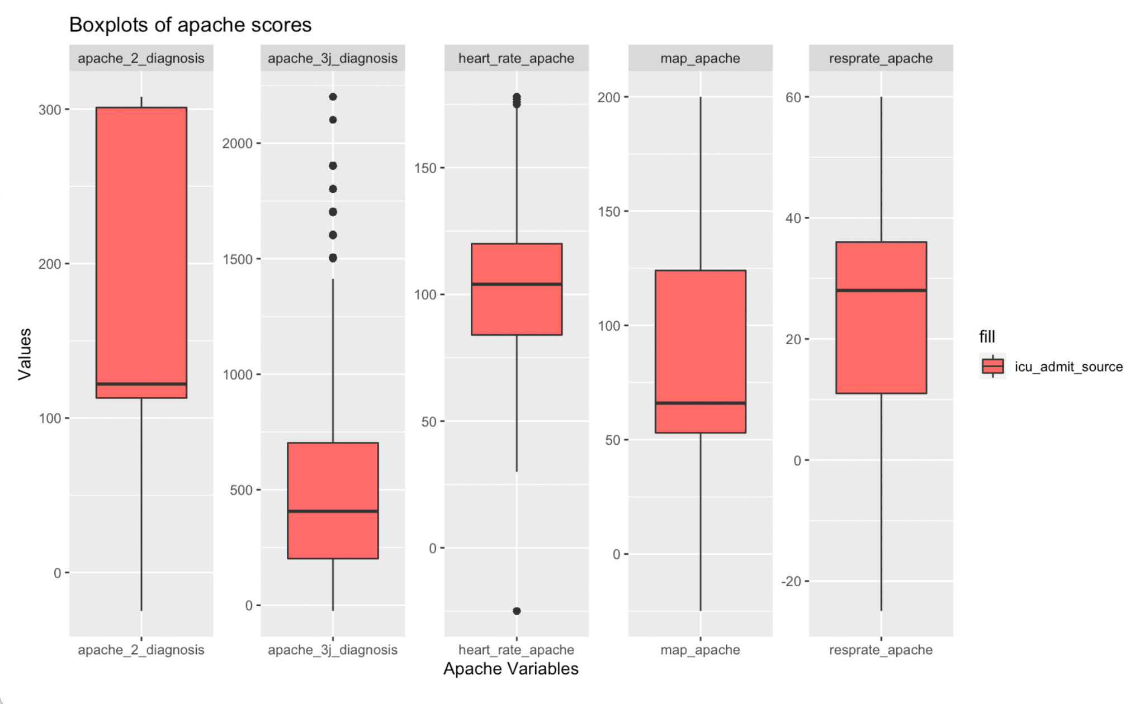
Data Visualization- Grouped Box plots
Apache 2 diagnosis lies in the range 110- 300, the median is at 120, it doesn't have any outliers.
Apache 3j diagnosis lies in the range 210- 700, the median is at, it has many outliers in the third quartile.
Heart rate apache lies between 80 to 120 and has few outliers
Map apache lies between 55 and 125, its median is at 60 and it doesn't have any outliers.
Resprate apache lies in the range 11 and 35, the median is at 28 and it does not have any outliers.
R

Slide 10
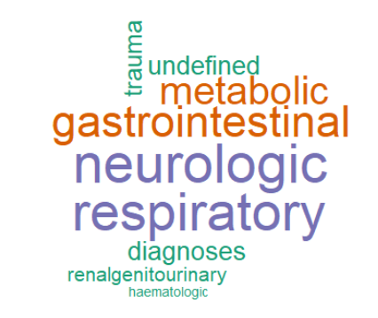
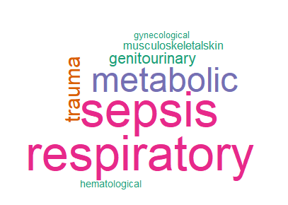
Data Visualization- Word clouds
Word Cloud 1: neurological, metabolic, trauma are the most frequent admitted group for Apache 3j body system
Word Cloud 2: respiratory, sepsis, metabolic, trauma are the most frequent admitted group for Apache 2 body system
C

Slide 11
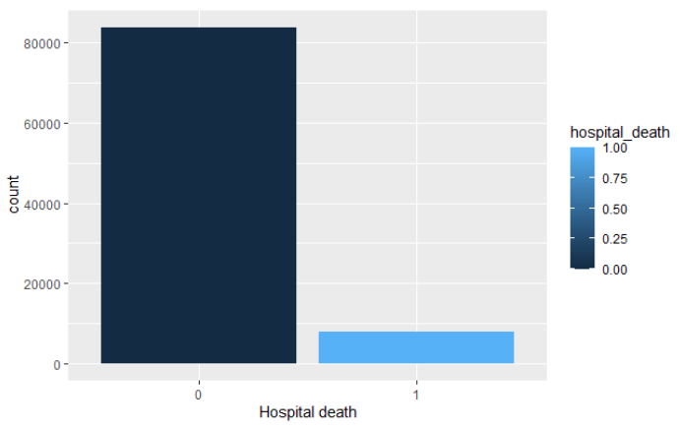
Data Overview
Dataset started with ~92k observations with 85 original variables
Dataset was highly unbalanced, with 86% of all hospital visits not leading to death. (thankfully!)
Training Data had to be undersampled for several models.
F

Slide 12
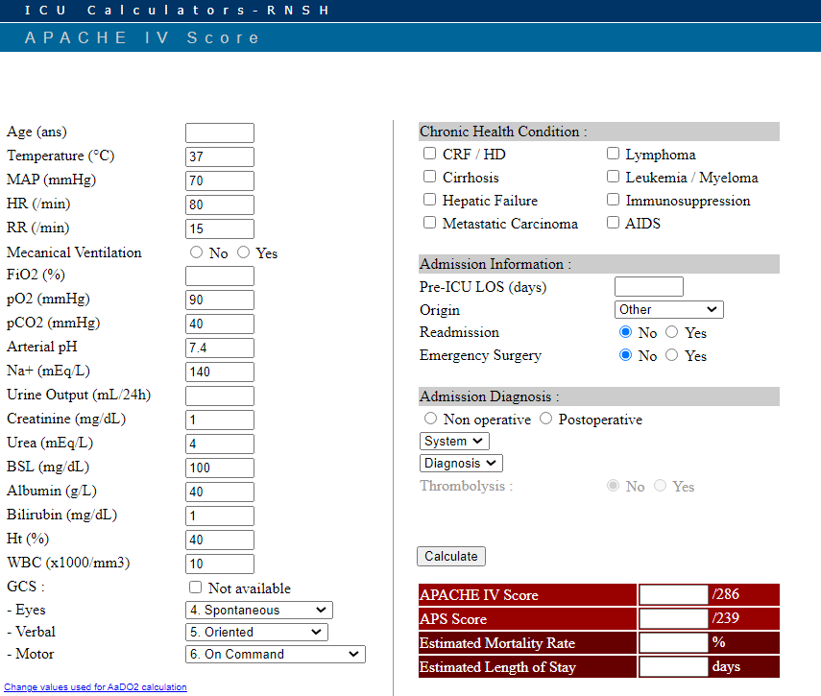
Apache 4A
Apache 4A predictors in the data set proved to be based on predictors already in data set, as well as others.
These calculation variables were heavily dominating the datasets, and thus we removed them for this project.
F

Slide 13
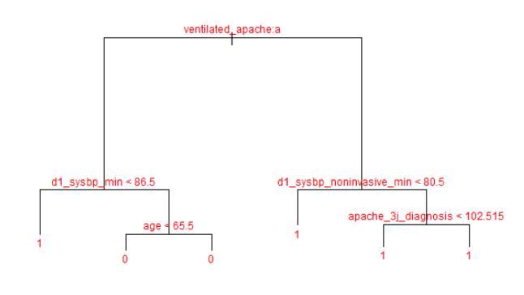
Method #1: Decision Tree
Quick and easy to interpret
Hospital death vs. all predictors (except death probabilities)
Proved to be pretty accurate, but not necessarily the most helpful
C

Slide 14
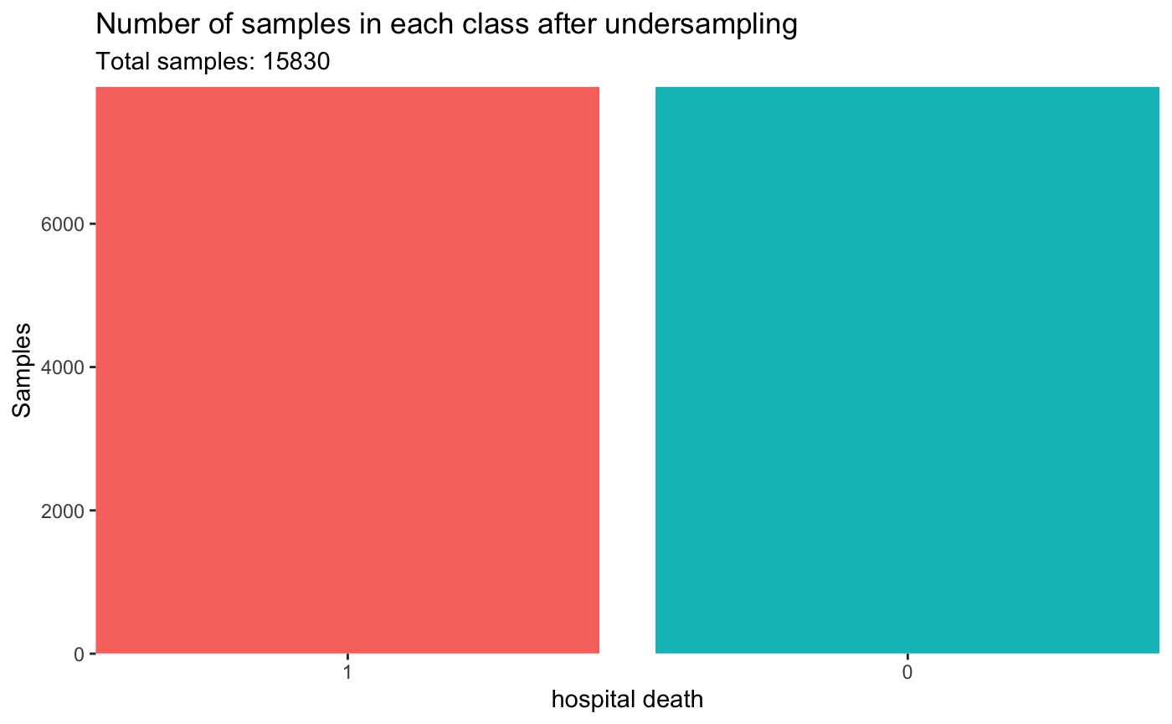
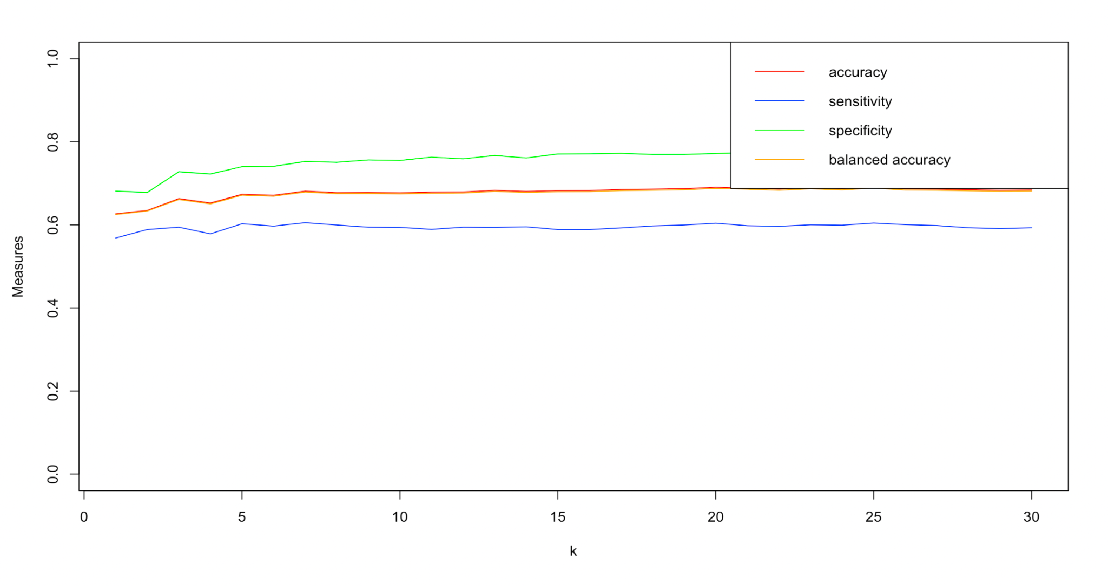
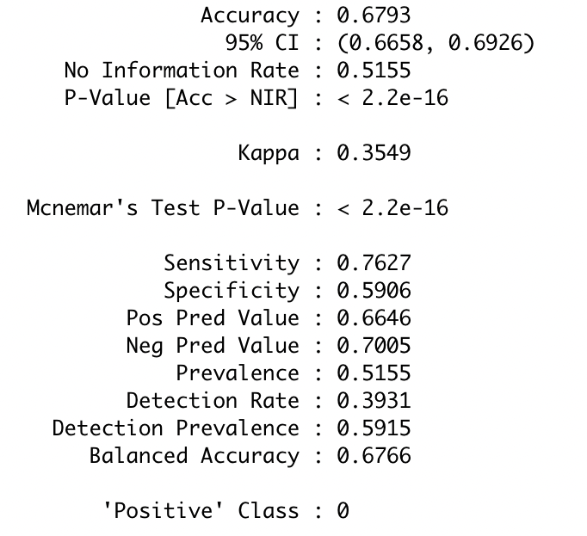
Method #2: kNN Classifier
Imbalance data handling
Undersampling the majority class i.e. 0 (alive)
ubBalance() of unbalanced package
K- nearest neighbors to predict whether a
patient admitted in the hospital will survive or not ?
Basic kNN model with k = 5
Hyper parameter tuning
k values from 1:30 (tunned)
Model performance evaluation
Sensitivity
Specificity
Balanced accuracy
Optimal hyperparameter
K =12
Model performance result
K = 5
Acc: 66.77% , bal acc: 66.69%
K = 12
Acc: 67.89%, bal acc: 67.79%
R

Slide 15
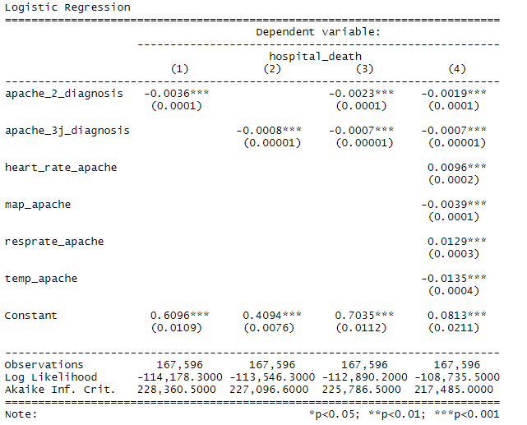
Method #3: Logistic Regression
The final logit model with out of sample prediction gives the accuracy score of 62% which is the same for in sample data. Giving us altogether the prediction of an admitted patient's survival in the hospital as 62%
B

Slide 16
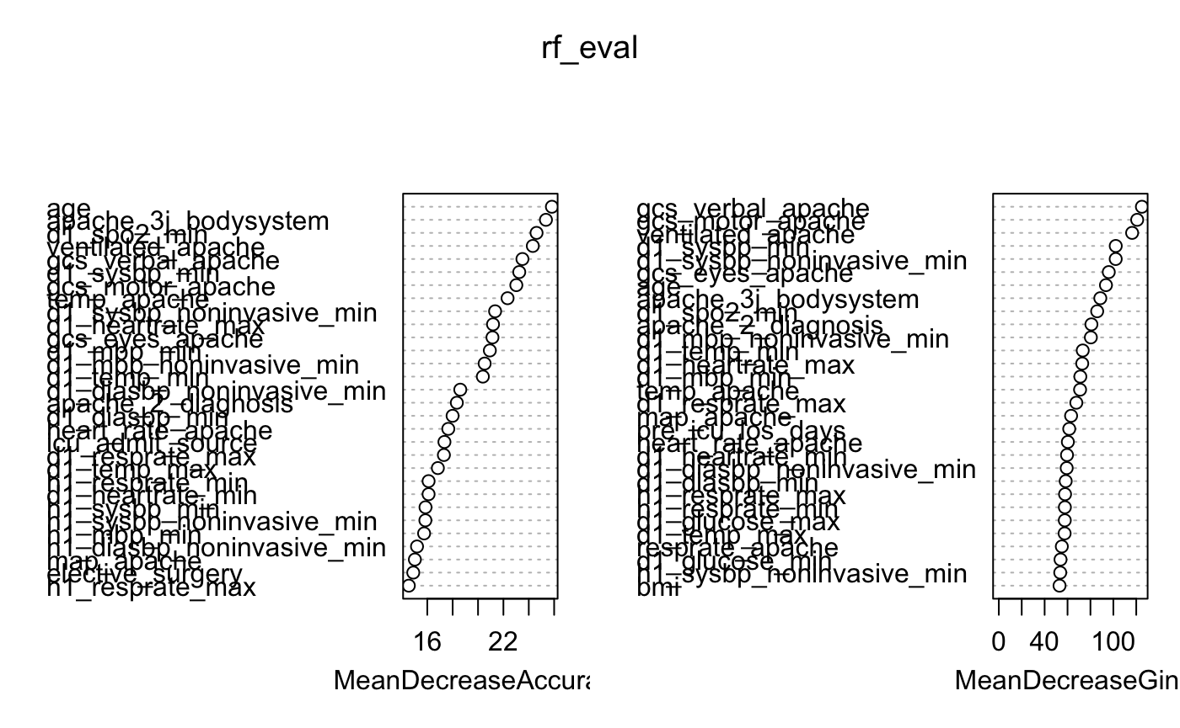
Method #4: Random Forest
RF revealed similar selections of factors, and served to prune lower relevance predictors, after removing the Apache 4A calculations.
F

Slide 17
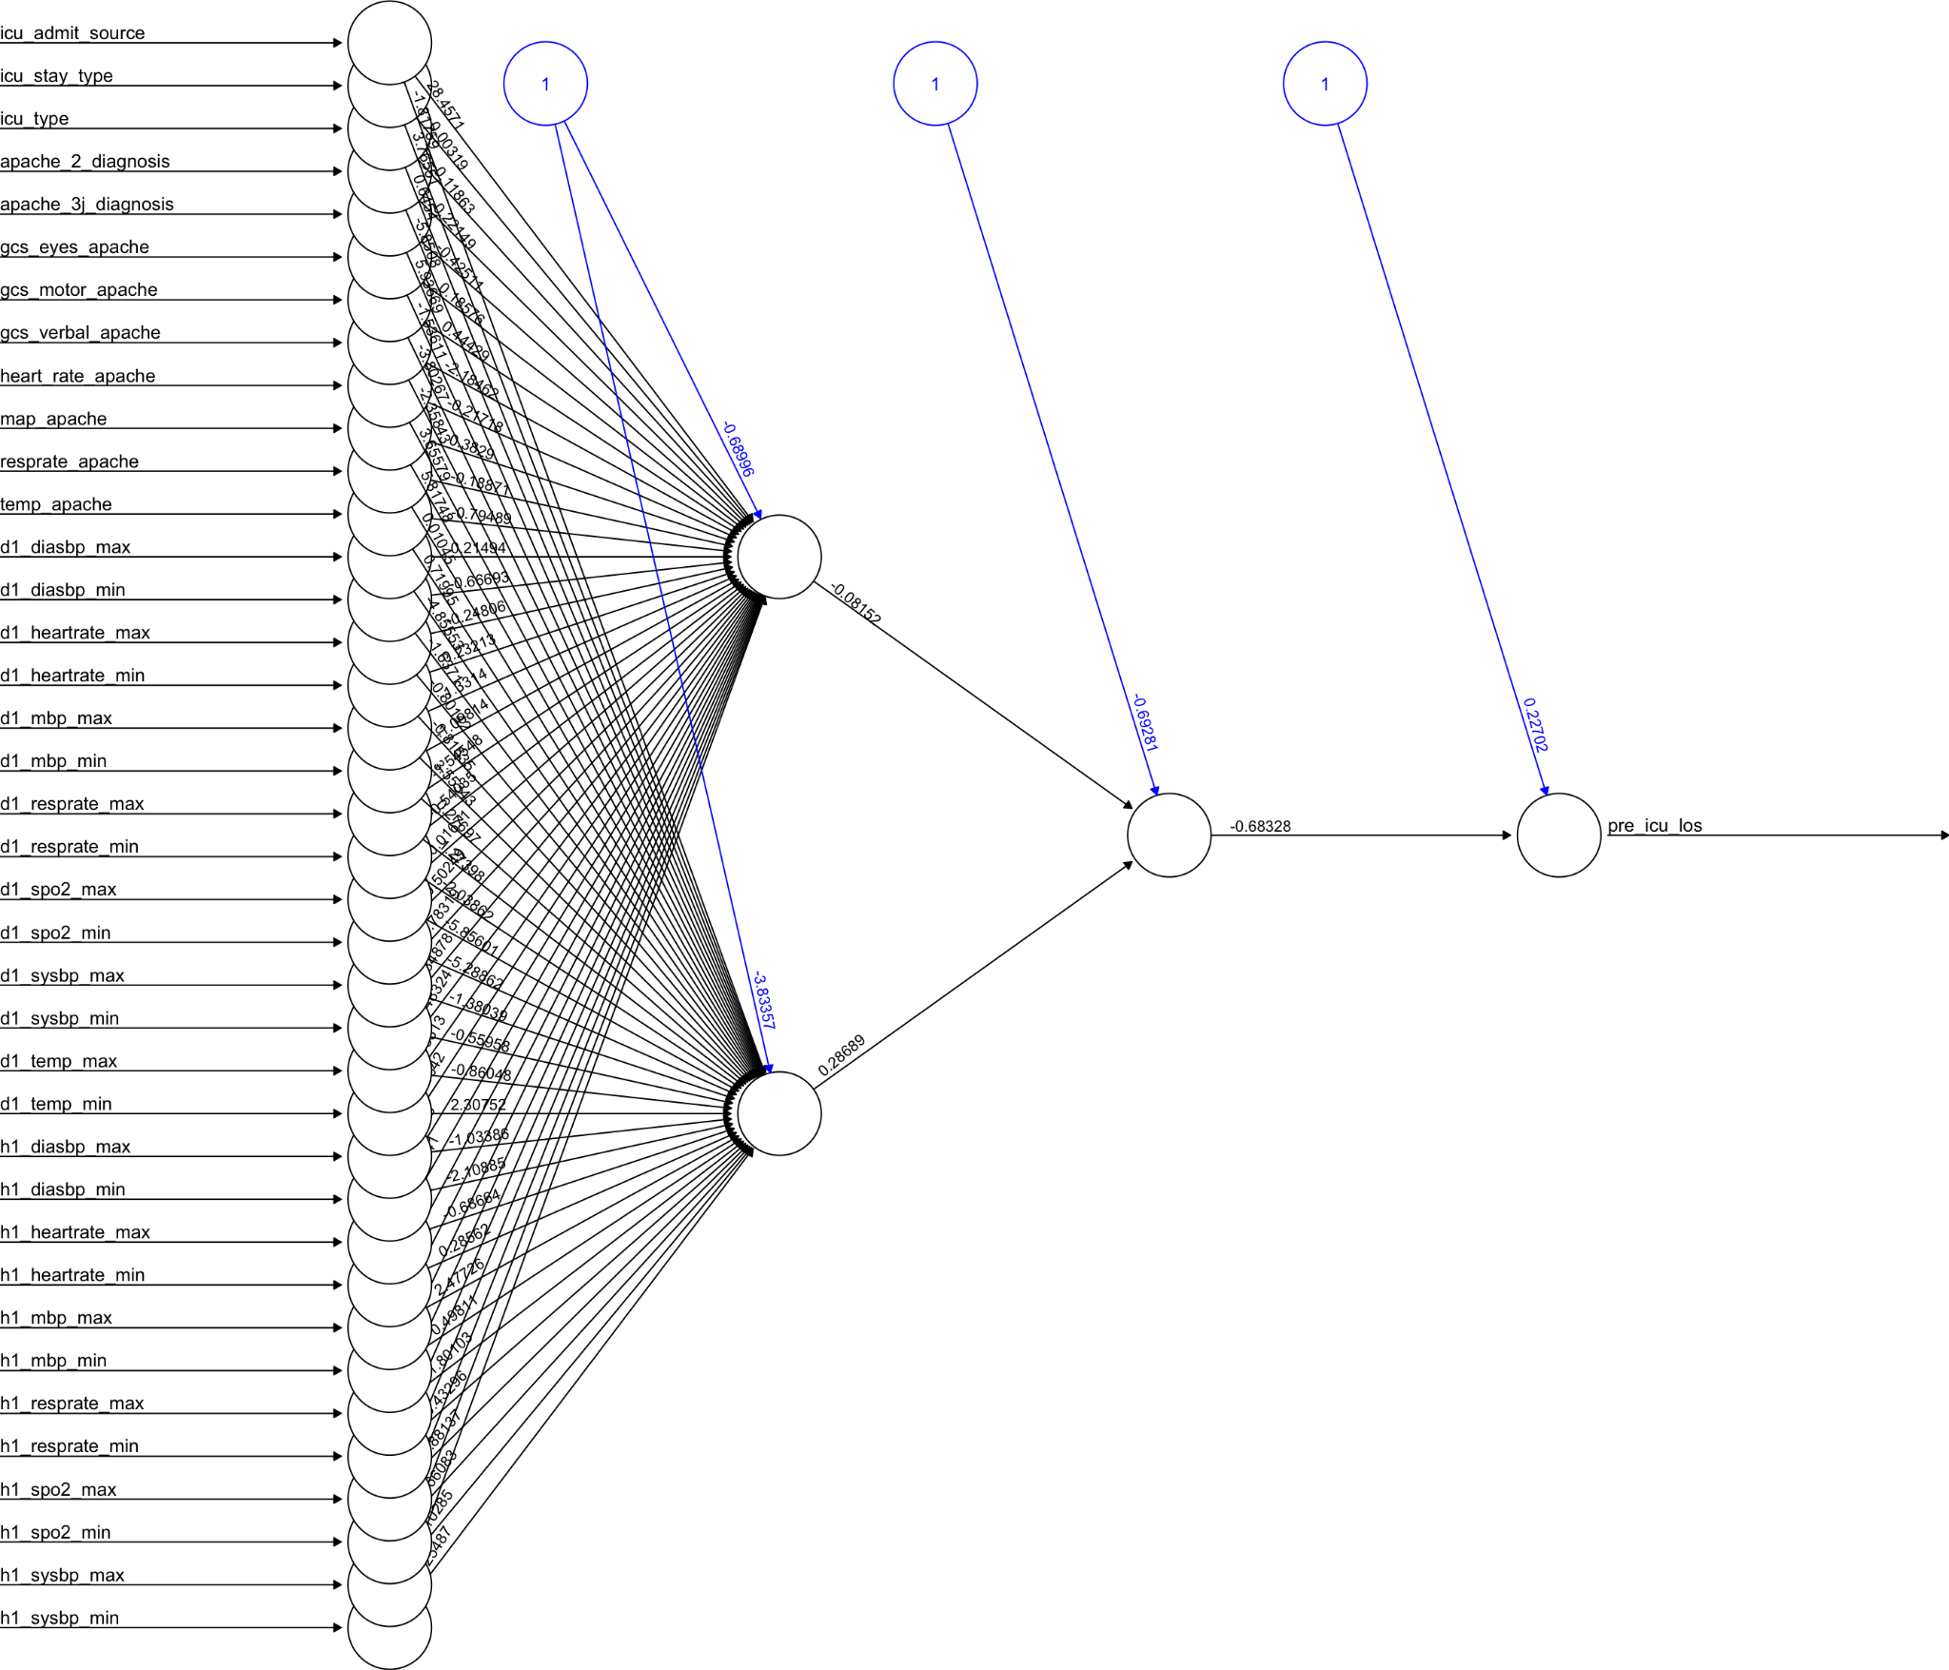
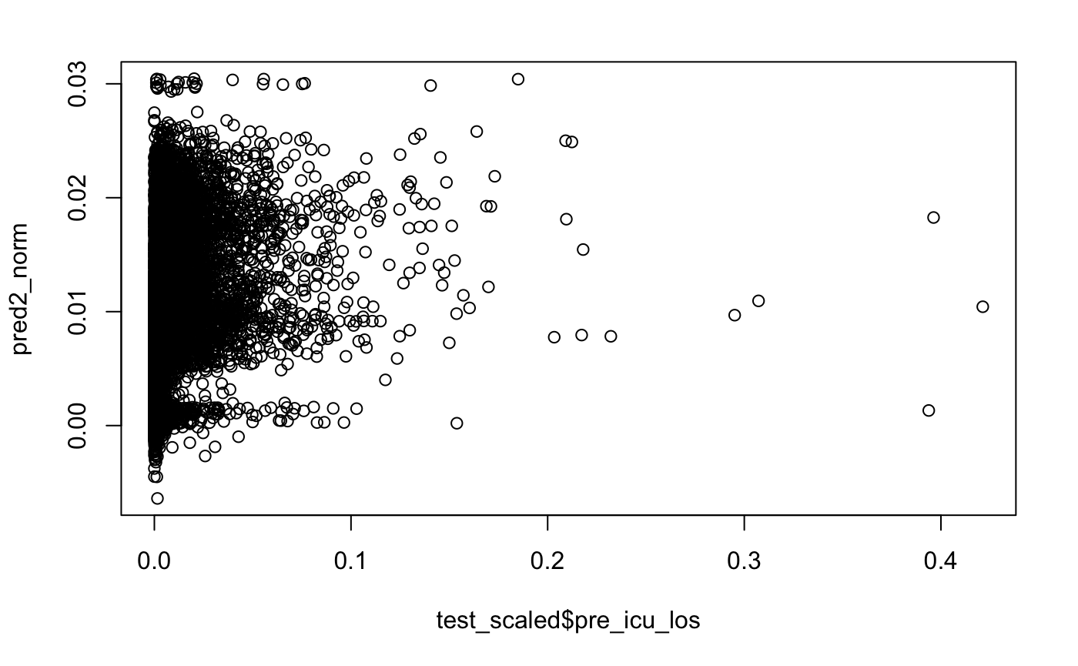

Method #5: ANN Model 1- 2 hidden layers
How many days will a patient be admitted to the ICU ward?
Scatter plot of predicted vs observed icu length of stay (los)
Response variable: pre icu los
Rounded(2) and absolute values taken
Categorical variables factored
icu admit source [5]
icu stay type [3]
icu type [8]
ANN Model 1 Layers
Input Layer: 38 inputs
Hidden layers: 2
1st 3 units, 2nd 2 units
Output layer: 1 (pre icu los)
ANN with 2 hidden layers
RMSE Rsquared MAE
2.245 0.158 0.870
R

Slide 18
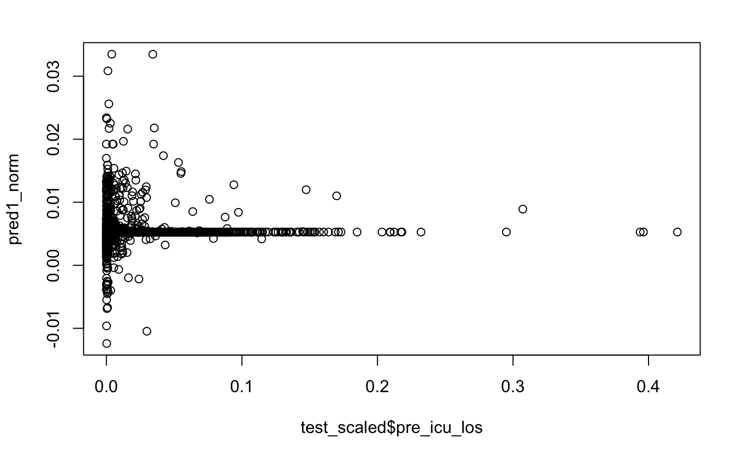
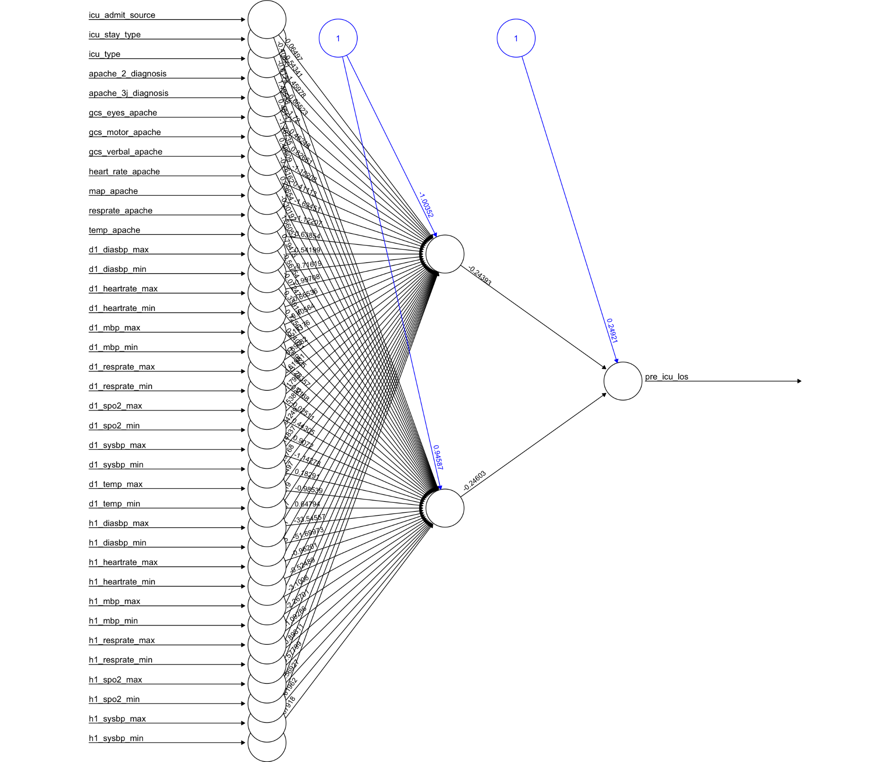
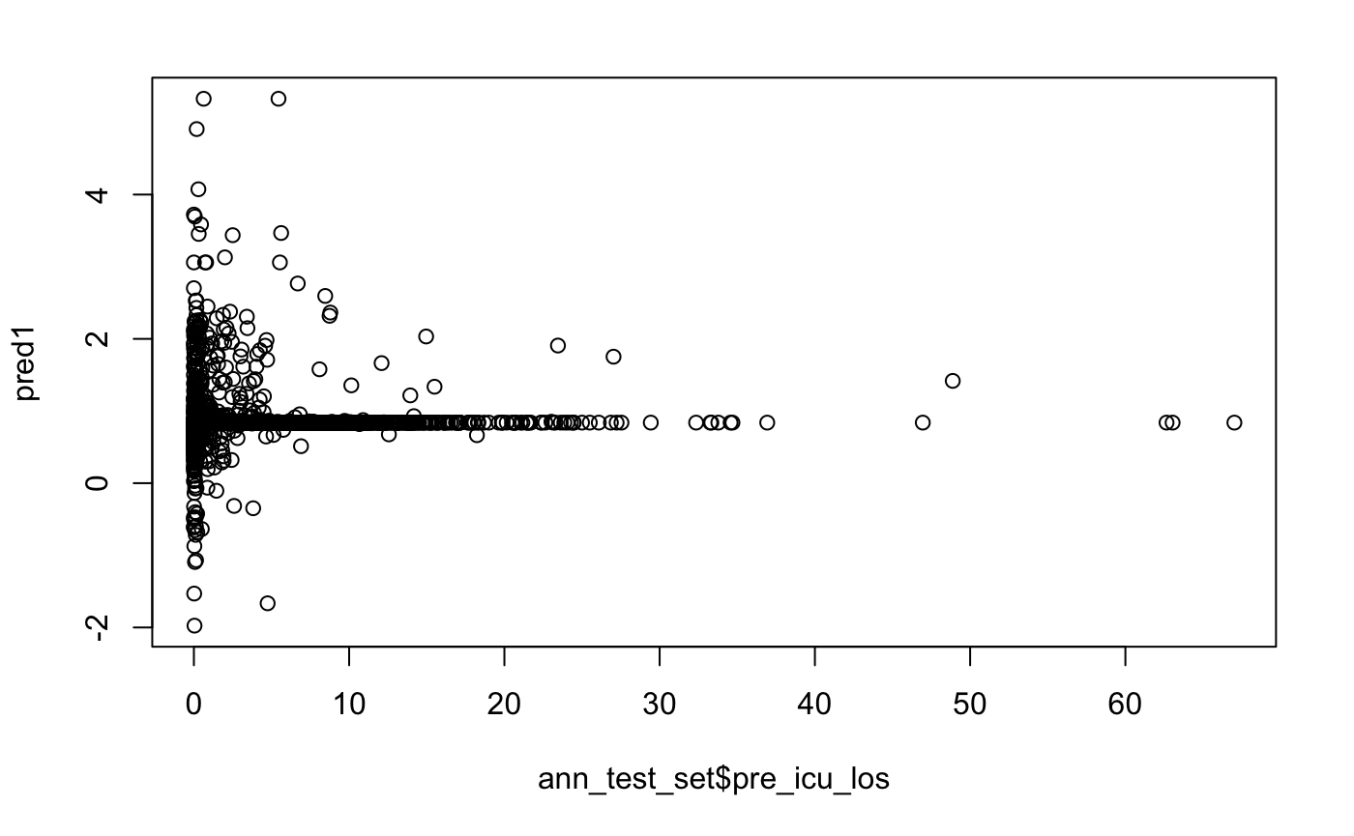
Method #5: ANN Model 2- 1 hidden layer
ANN Model 2 Layers
Input Layer: 38 inputs
Hidden layers: 1
2 units
Output layer: 1
RMSE Rsquared MAE
2.44500 0.00172 1.14488
ANN model performance comparison
Model 1 with 2 hidden layers
Rsquared 0.158
Model 2 with 1 hidden layer
Rsquared 0.00172
ANN with 1 hidden layer
R

Slide 19
Data Summary
Random Forest outperformed all other models fairly significantly. Once the bottom 25 predictors were dropped, and RF was tuned, Accuracy came out at 79.9% on the Test set.
 | Accuracy | Kappa
RF Variable Selection | 76.7% | 0.26
Decision Tree | 69.0%
KNN12 | 69.3% | 0.38
Logistic Regression | 62.2% | 0.24
ANN | Model 1 R2 0.158
RF Trimmed | 79.9% | 0.308
F

Slide 20
Conclusion
Apache 4A predictor present in the dataset proved to be an excellent aggregate predictor of hospital deaths in the dataset, and vastly outperforms all other predictors by a factor of 5 when initially evaluated for the model.
After removing this calculation from the dataset, we were able to assess the raw data in a way that approached the same region that we observed with the apache 4A predictor, which further reinforces that this basis for this predictor is a good baseline for hospital outcomes.
F

Slide 21
Questions?

